Slide 1
Tim Allen
Recovery ANALYTICS DIVISION

Slide 2
Why R?
Data Management
Obtain data from anywhere: Excel, Oracle, CSV, WinCATI, Free text, XML, PDF, HTML, MySQL, Hadoop, JSON, HDF5, SPSS, SAS, MiniTab…
Manipulate with readr & dplyr – (Someone say: “Hey Tim, demo Julia’s PA Versioning Problem!”)
Markdown: Script once, run many
Wide Support
6,962 free libraries–statistical methodologies, data formats, integration with software…
Built-in help, manuals, free online classes (Coursera)
Free, free, and free

Slide 3

Why R?
Data Science is so hot right now
and R is the Lingua Franca

Slide 4
Top 10 Things (R does really, really well)
10. Obtain data from many sources
9. Read in CSV files
8. Slice and Visualize data
7. Explore the data graphically
6. Extend R with libraries
5. Load Excel data without unmerging cells
4. Find missing data
3. Model missing values

Slide 5
2. Regression Modeling
One predictor variable (independent variable)
One response variable (dependent variable)
Model the underlying process
Understand relationship
Predict new values

Slide 6
1. Multiple Regression Modeling
Multiple predictor variables
One response variable
Watch out for overmodeling!

Slide 7
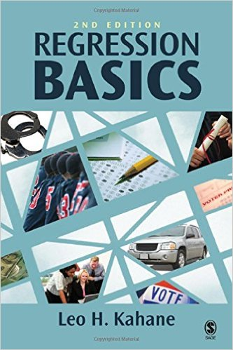
Books About Regression
Regression Basics – Leo H. Kahane – The best primer I’ve found
R Cookbook – Paul Teetor – Explains diagnostics well
Empirical Model-Building and Response Surfaces – Box & Draper – Definitive, great appendices for forgotten matrix math

Slide 8
Supercharging R
Learn more advanced packages
dplyr – data manipulation
ggplot2 – advanced graphics
sqldf – query dataframes with SQL
lubridate – sane data manipulation
NLP – Natural Language Processing/Text Mining
Take a Data Science course (free/cheap)
Learn more stats
What’s a p-value?

